Slide 1








C836 Pacing - Speedy Pacing (1 to 2 Weeks)
Check In, Readjust Plan as Needed
7 days
14 days
Week 1
Week 2
Pre-Assessment
Take the Pre-Assessment and schedule an introductory call with the Course Instructor (CI) to develop a course plan using course planning tool results and coaching report in Week 1.
Lessons 1-6
Lessons 7-14
Readiness Check
1 WHAT IS INFORMATION SECURITY?
pp 17-34; 18 pages
2 IDENTIFICATION AND AUTHENTICATION
pp 35-45; 11 pages
3 AUTHORIZATION AND ACCESS CONTROLS
pp 46-58; 13 pages
4 AUDITING AND ACCOUNTABILITY
pp 59-67; 9 pages
5 CRYPTOGRAPHY
pp 68-83; 16 pages
6 COMPLIANCE, LAWS, AND REGULATIONS
pp 84-97; 14 pages
7 OPERATIONS SECURITY
pp 98-107; 10 pages
8 HUMAN ELEMENT SECURITY
pp 108-119; 12 pages
9 PHYSICAL SECURITY
pp 120-130; 11 pages
10 NETWORK SECURITY
pp 131-142; 12 pages
11 OPERATING SYSTEM SECURITY
pp 143-153; 11 pages
12 MOBILE, EMBEDDED, AND INTERNET OF THINGS SECURITY
pp 154-167; 14 pages
13 APPLICATION SECURITY
pp 168-180; 13 pages
14 ASSESSING SECURITY
pp 181-195; 15 pages
Take Objective Assessment

Slide 2
C836 Pacing - Steady Pacing (2 to 4 Weeks)
Check In, Readjust Plan as Needed
7 days
14 days
21 days
28 days
Week 1
Week 2
Week 3
Week 4
Pre-Assessment
Take the Pre-Assessment and schedule an introductory call with the Course Instructor (CI) to develop a course plan using course planning tool results and coaching report in Week 1.
Lessons 1-6
Lessons 7-14
Readiness Check
1 WHAT IS INFORMATION SECURITY?
pp 17-34; 18 pages
2 IDENTIFICATION AND AUTHENTICATION
pp 35-45; 11 pages
3 AUTHORIZATION AND ACCESS CONTROLS
pp 46-58; 13 pages
4 AUDITING AND ACCOUNTABILITY
pp 59-67; 9 pages
5 CRYPTOGRAPHY
pp 68-83; 16 pages
6 COMPLIANCE, LAWS, AND REGULATIONS
pp 84-97; 14 pages
7 OPERATIONS SECURITY
pp 98-107; 10 pages
8 HUMAN ELEMENT SECURITY
pp 108-119; 12 pages
9 PHYSICAL SECURITY
pp 120-130; 11 pages
10 NETWORK SECURITY
pp 131-142; 12 pages
11 OPERATING SYSTEM SECURITY
pp 143-153; 11 pages
12 MOBILE, EMBEDDED, AND INTERNET OF THINGS SECURITY
pp 154-167; 14 pages
13 APPLICATION SECURITY
pp 168-180; 13 pages
14 ASSESSING SECURITY
pp 181-195; 15 pages
Take Objective Assessment

Slide 3
C836 Pacing - Deliberate Pacing (4 to 6 Weeks)
Check In, Readjust Plan as Needed
7 days
14 days
21 days
28 days
35 days
42 days
Week 1
Week 2
Week 3
Week 4
Week 5
Week 6
Pre-Assessment
Lessons 1-4
1 WHAT IS INFORMATION SECURITY?
pp 17-34; 18 pages
2 IDENTIFICATION AND AUTHENTICATION
pp 35-45; 11 pages
3 AUTHORIZATION AND ACCESS CONTROLS
pp 46-58; 13 pages
4 AUDITING AND ACCOUNTABILITY
pp 59-67; 9 pages
Lessons 5-8
5 CRYPTOGRAPHY
pp 68-83; 16 pages
6 COMPLIANCE, LAWS, AND REGULATIONS
pp 84-97; 14 pages
7 OPERATIONS SECURITY
pp 98-107; 10 pages
8 HUMAN ELEMENT SECURITY
pp 108-119; 12 pages
Lessons 9-14
9 PHYSICAL SECURITY
pp 120-130; 11 pages
10 NETWORK SECURITY
pp 131-142; 12 pages
11 OPERATING SYSTEM SECURITY
pp 143-153; 11 pages
12 MOBILE, EMBEDDED, AND INTERNET OF THINGS SECURITY
pp 154-167; 14 pages
13 APPLICATION SECURITY
pp 168-180; 13 pages
14 ASSESSING SECURITY
pp 181-195; 15 pages
Readiness Check
Take Objective Assessment

Slide 4
NEXT SLIDES as PICTURES of the SLIDES

Slide 5
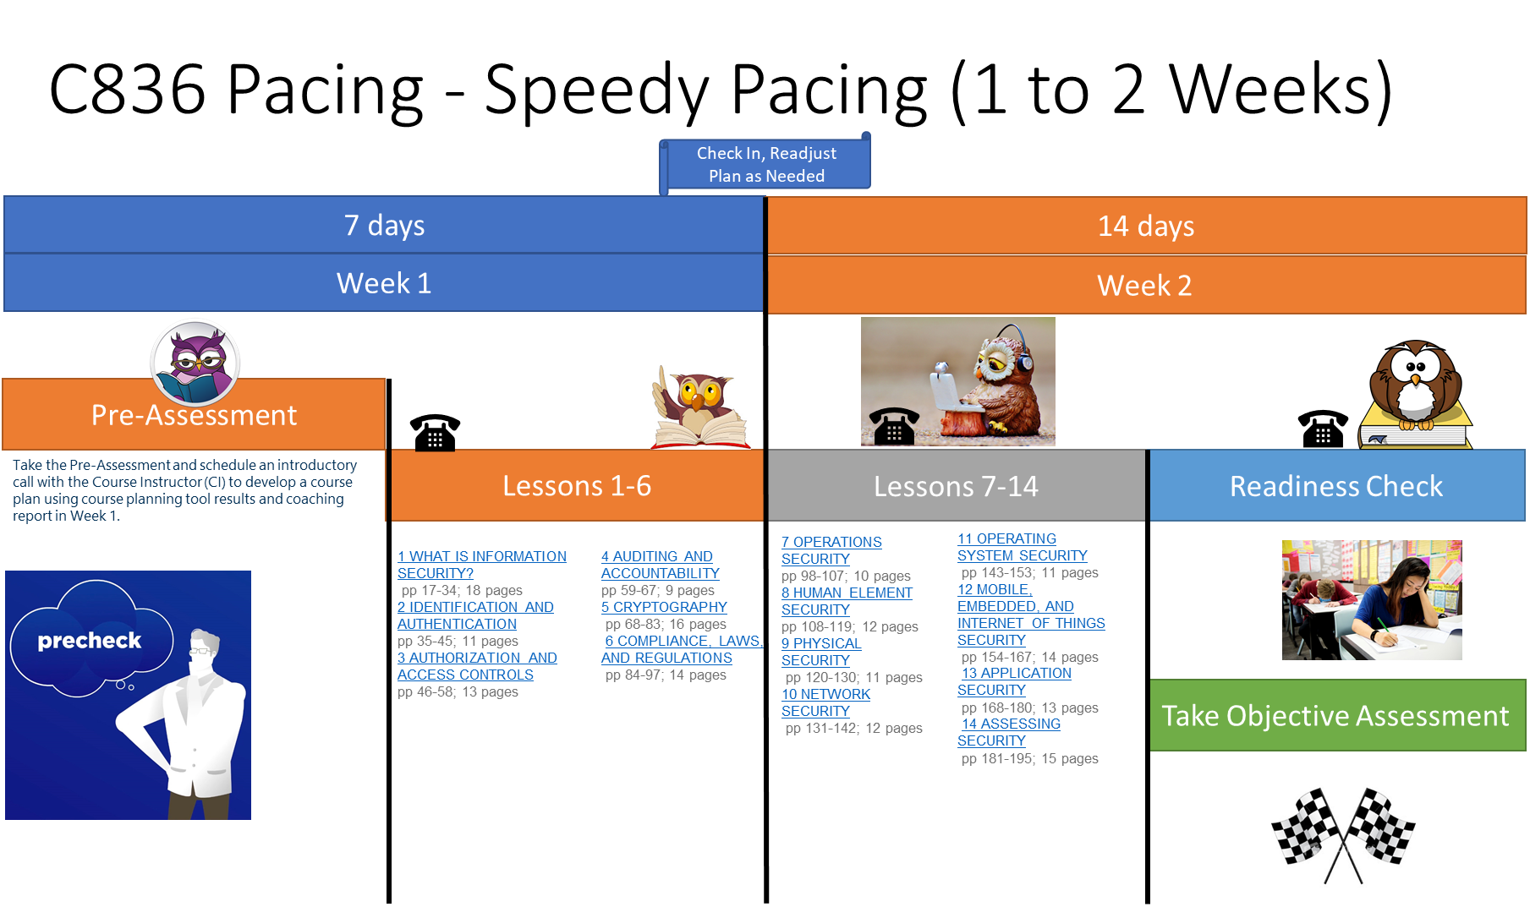

Slide 6
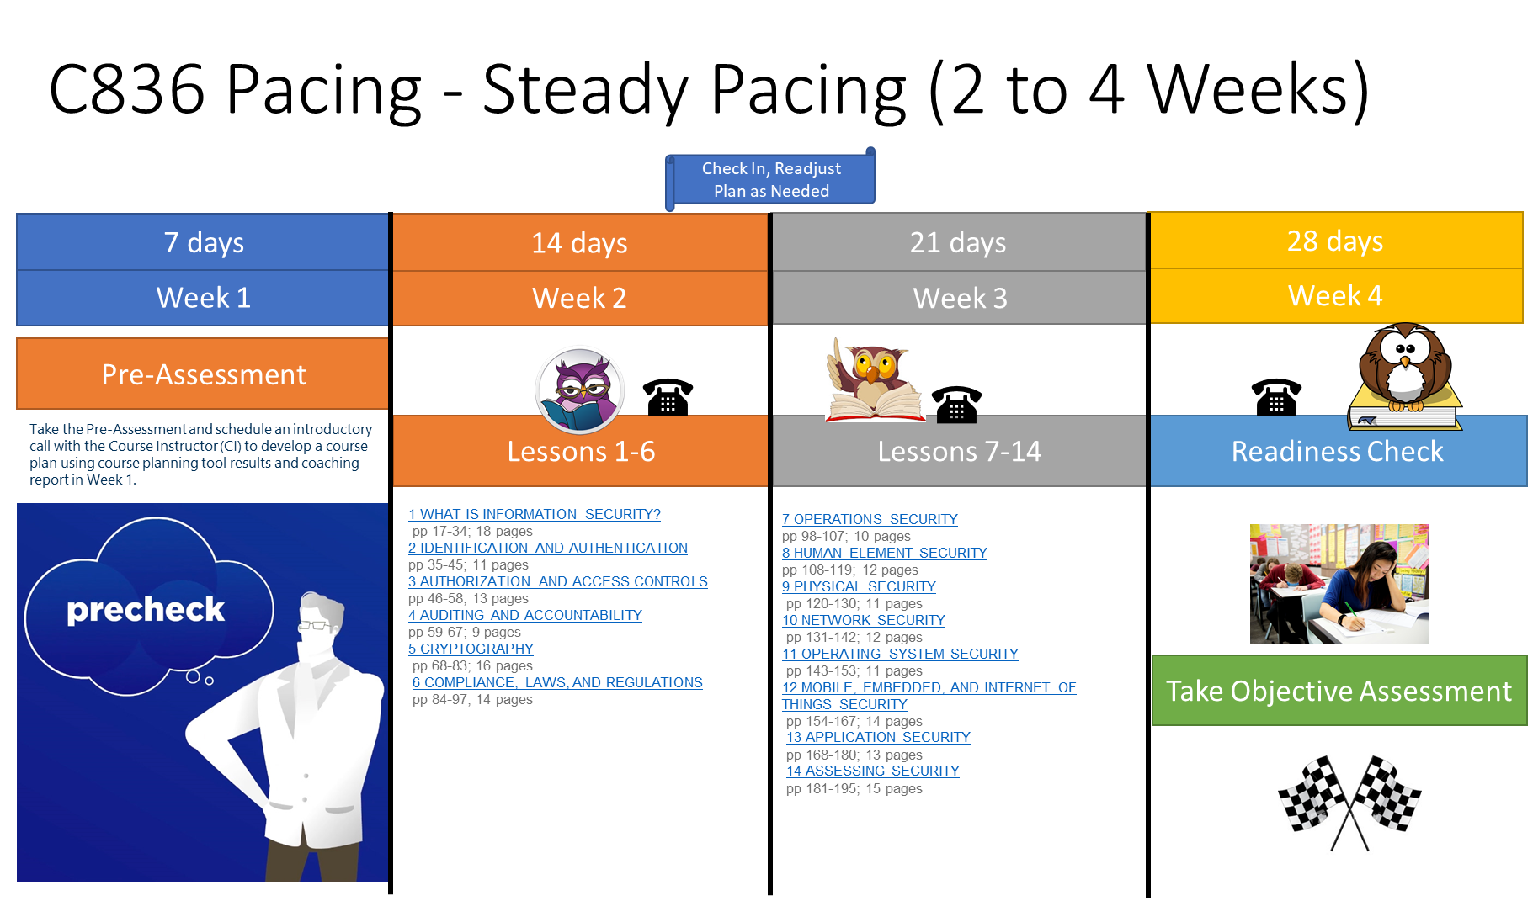

Slide 7
